Slide 1

FormsiQ Mortgage Application
- AI-powered loan insights with Deepa Nalla

Slide 2
Agenda
Problem Statement & Objective
Solution
Tools used
Application architecture
Solution approach
About Gemini 1.5
About Whisper
Validation checks
FastAPI endpoint
UI Sample
Test Results – Positive and Negative scenarios
Conclusion

Slide 3
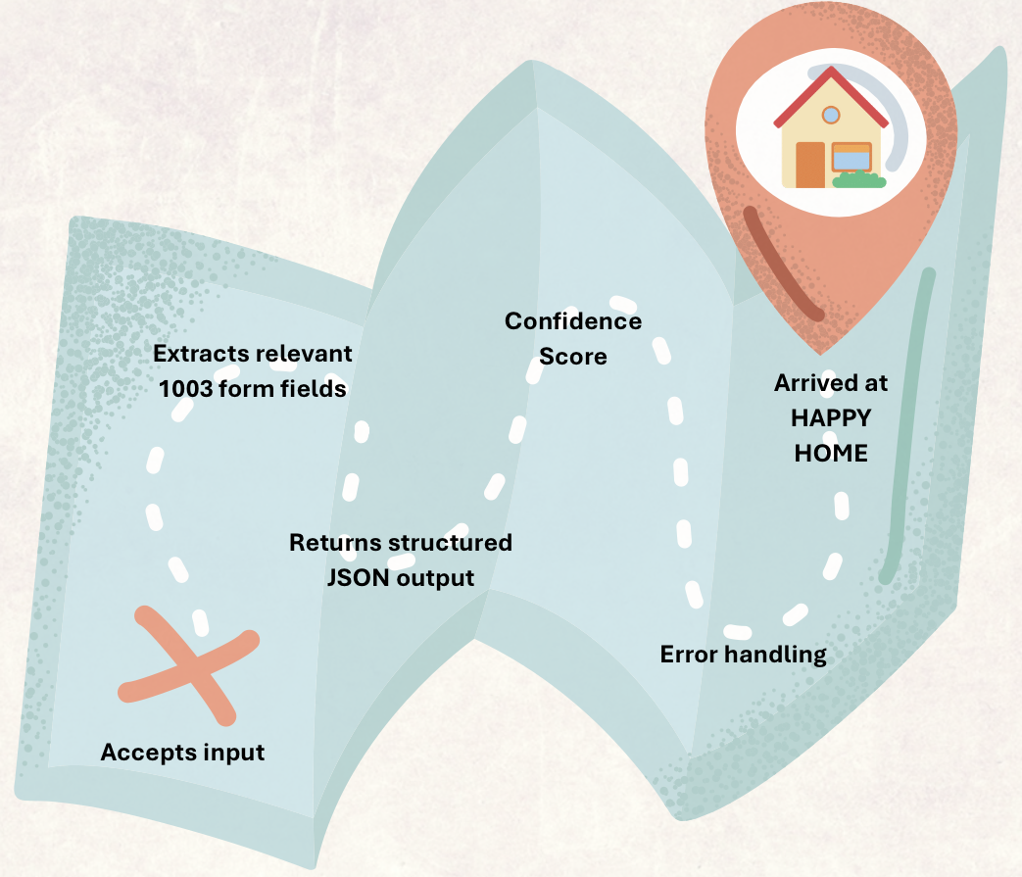
Problem Statement & Objective
Problem – Mortgage providers often conduct phone-based customer service calls that contain critical data required to fill standardized forms like the 1003 Uniform Residential Loan Application.
Goal – To automate extraction of form fields from audio or text transcripts of customer service calls using AI.
Objective –

Slide 4
Friends who helped with my application
Libraries
FastAPI
Pydantic
Json
Whisper
Gradio
Requests
AI Tools
Gemini 1.5
Whisper
Gradio
FastAPI
Other
Try-except error handling
Validation techniques
Virtual environment
Temporary file handling
VS code editor
..many more!

Slide 5
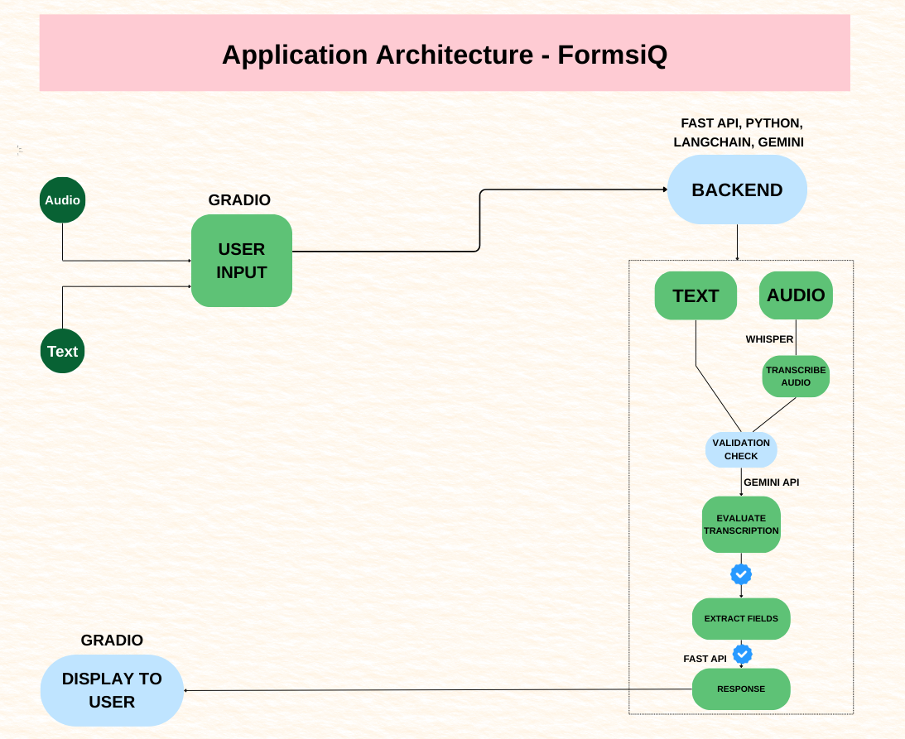

Slide 6
Solution Approach
Set up a virtual environment and installed required libraries
Configured the Google API key and initialized the FastAPI application
Loaded and initialized Whisper from open-source GitHub repository
Defined Pydantic models for request and response validation
Created Helper function for transcribing audio using Whisper
Defined /extract-fields endpoint for field extraction from text input
Initialized Gemini model for structured prompt-based extraction
Defined /process-audio endpoint for handling audio input
Used the Helper function to transcribe audio and extract transcript text
Routed the transcript to Gemini model for mortgage field extraction

Slide 7
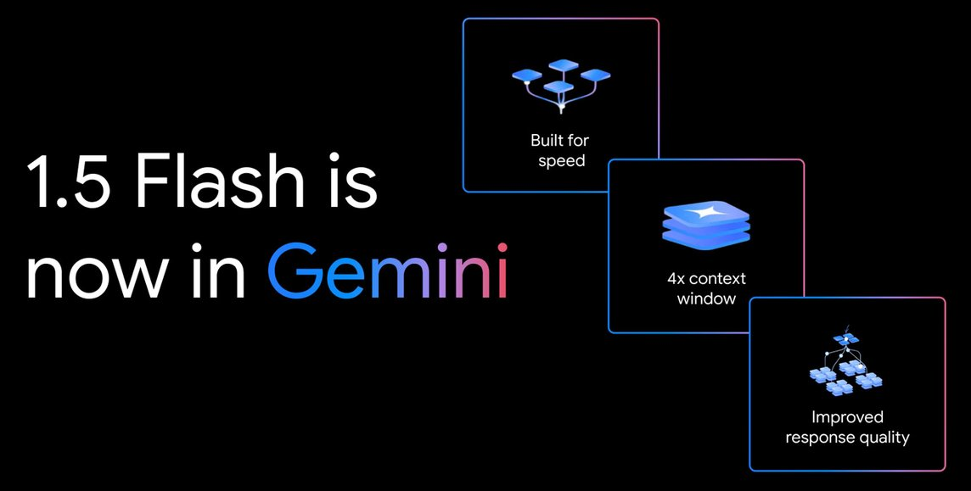
About Gemini 1.5 Flash
Lightweight, Low-latency variant
Extended Token limit
Multimodal – accepts text, image, whisper-transcribed audio
Integrates with tools and APIs
Confidence scoring enabled by large-scale training
Prompt-based Query handling
Speed and cost efficient

Slide 8
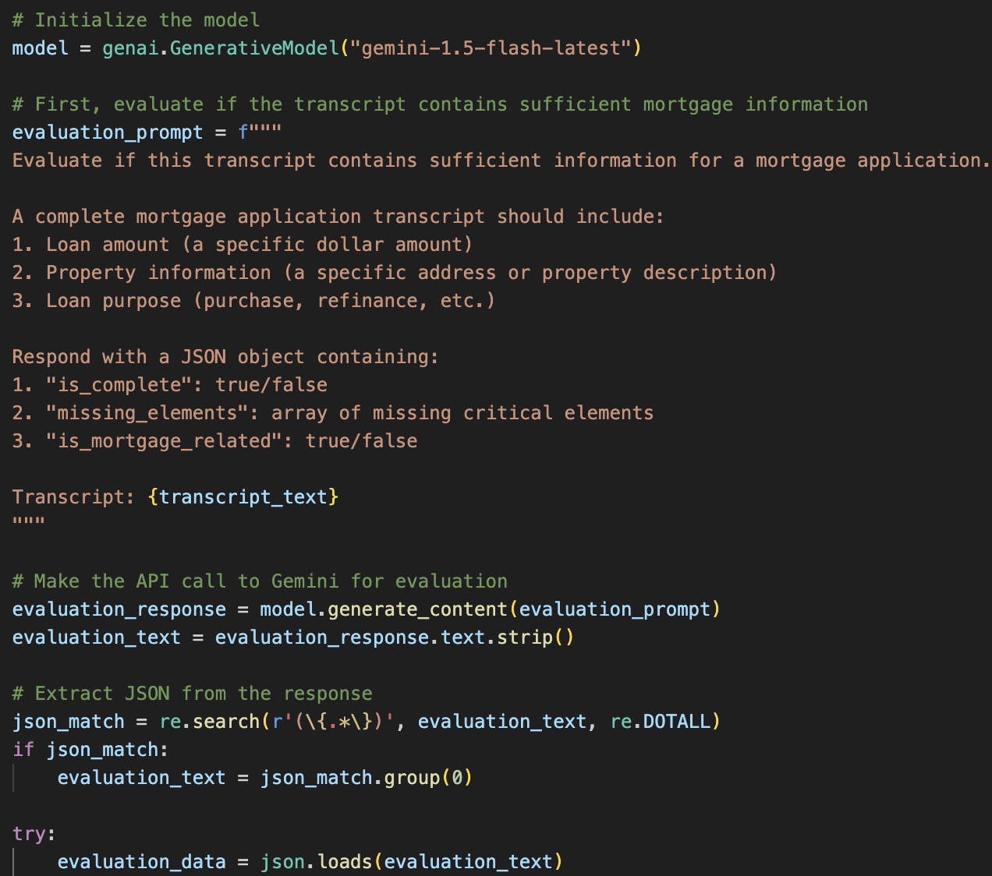
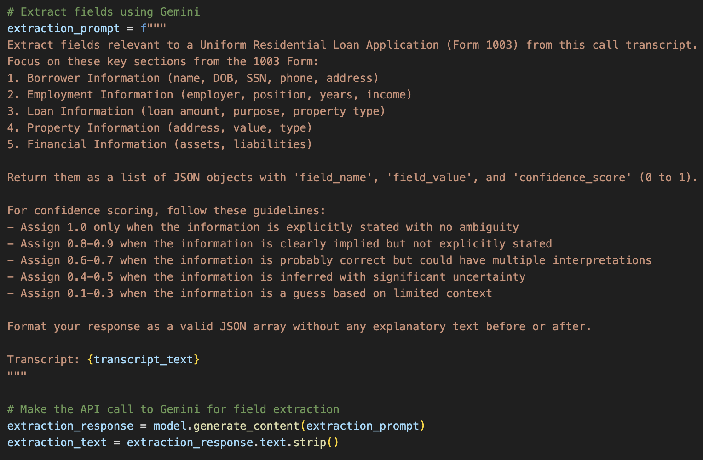
Code snippet - Prompts
Checks if transcript contains enough information for a valid mortgage application
Extracts specific fields from the transcript (loan amount, property type and borrower details) and assigns confidence score

Slide 9
About Whisper
Whisper is an open-source automatic speech recognition (ASR) model developed by OpenAI, released in 2022.
Used Whisper GitHub repository and transcription output sent to Gemini API for 1003 field extraction.
One of the most robust ASR systems available.
Multitask Functionalities like speech-to-text transcription and language identification.
Performs well on real-world phone calls, customer service recordings, podcasts, etc
Handles domain-specific terminology (e.g., mortgage, interest rate, refinance) better due to massive training data.

Slide 10
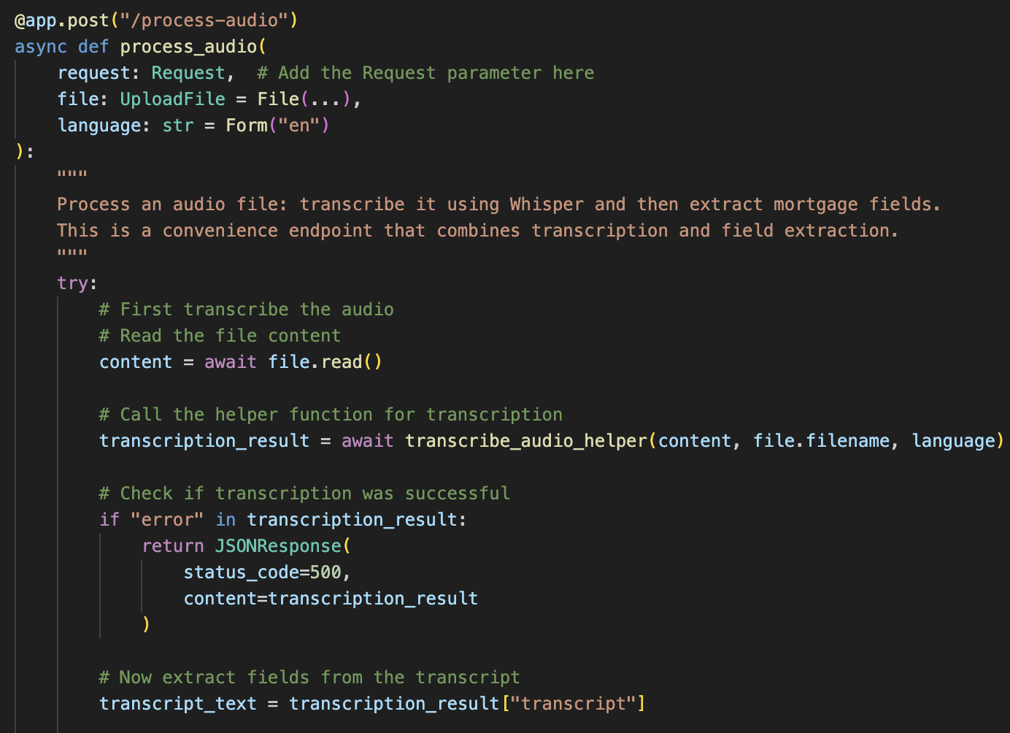
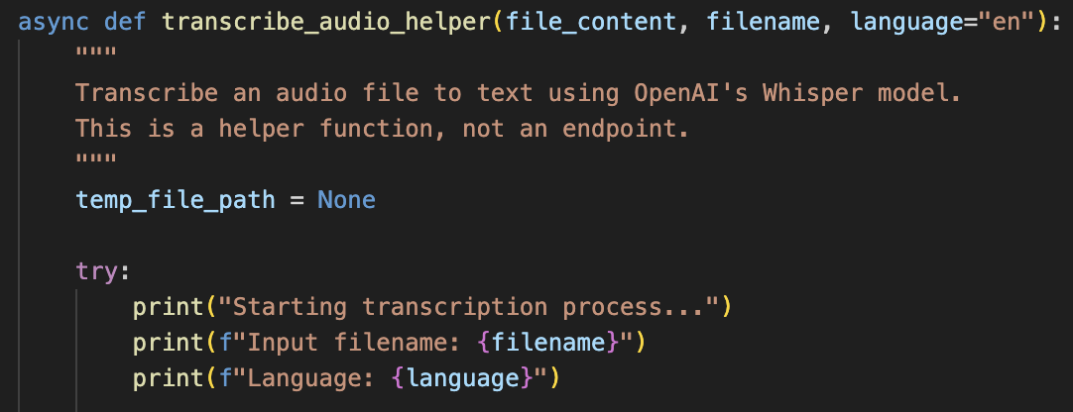
Code snippet - Whisper
Helper function that uses OpenAI’s whisper model to transcribe uploaded audio file
Calls the transcription helper and passes transcribed text to Gemini for field extraction

Slide 11
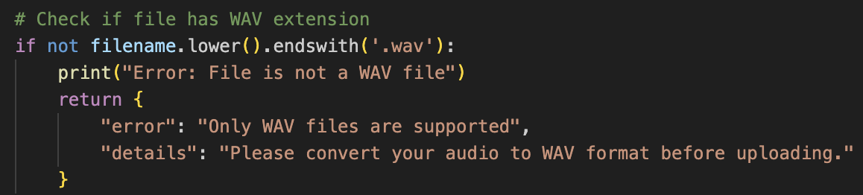
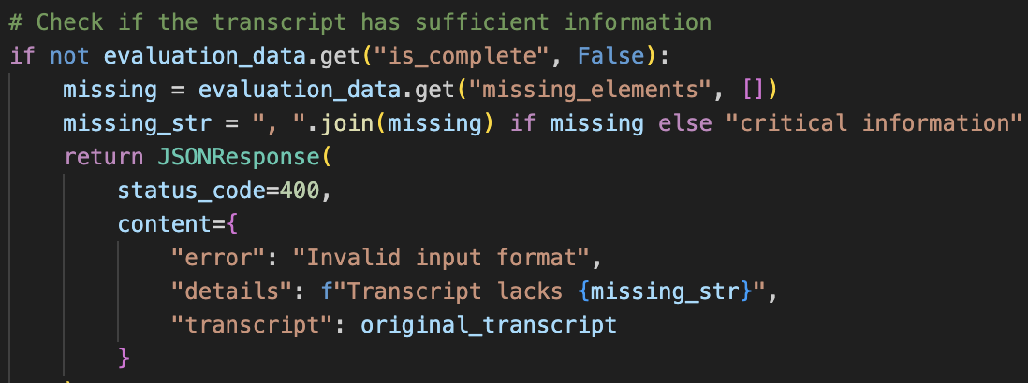
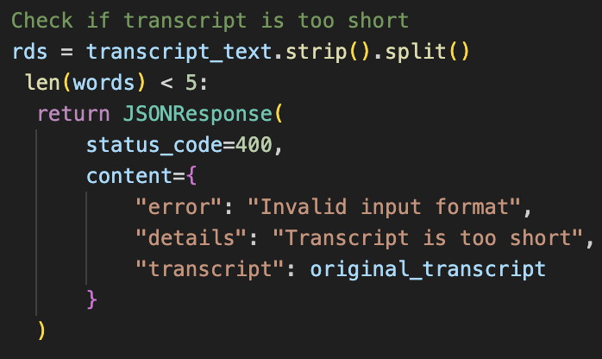
Validation checks
This snippet helps to check file format to ensure if the uploaded audio file is in (.wav) format before processing. This prevents invalid input and avoids processing time
This code block checks if transcript content has enough information to process further for 1003 field extraction.
This is useful to check whether transcript text is too short to be useful for processing. It helps in reducing false positives

Slide 12
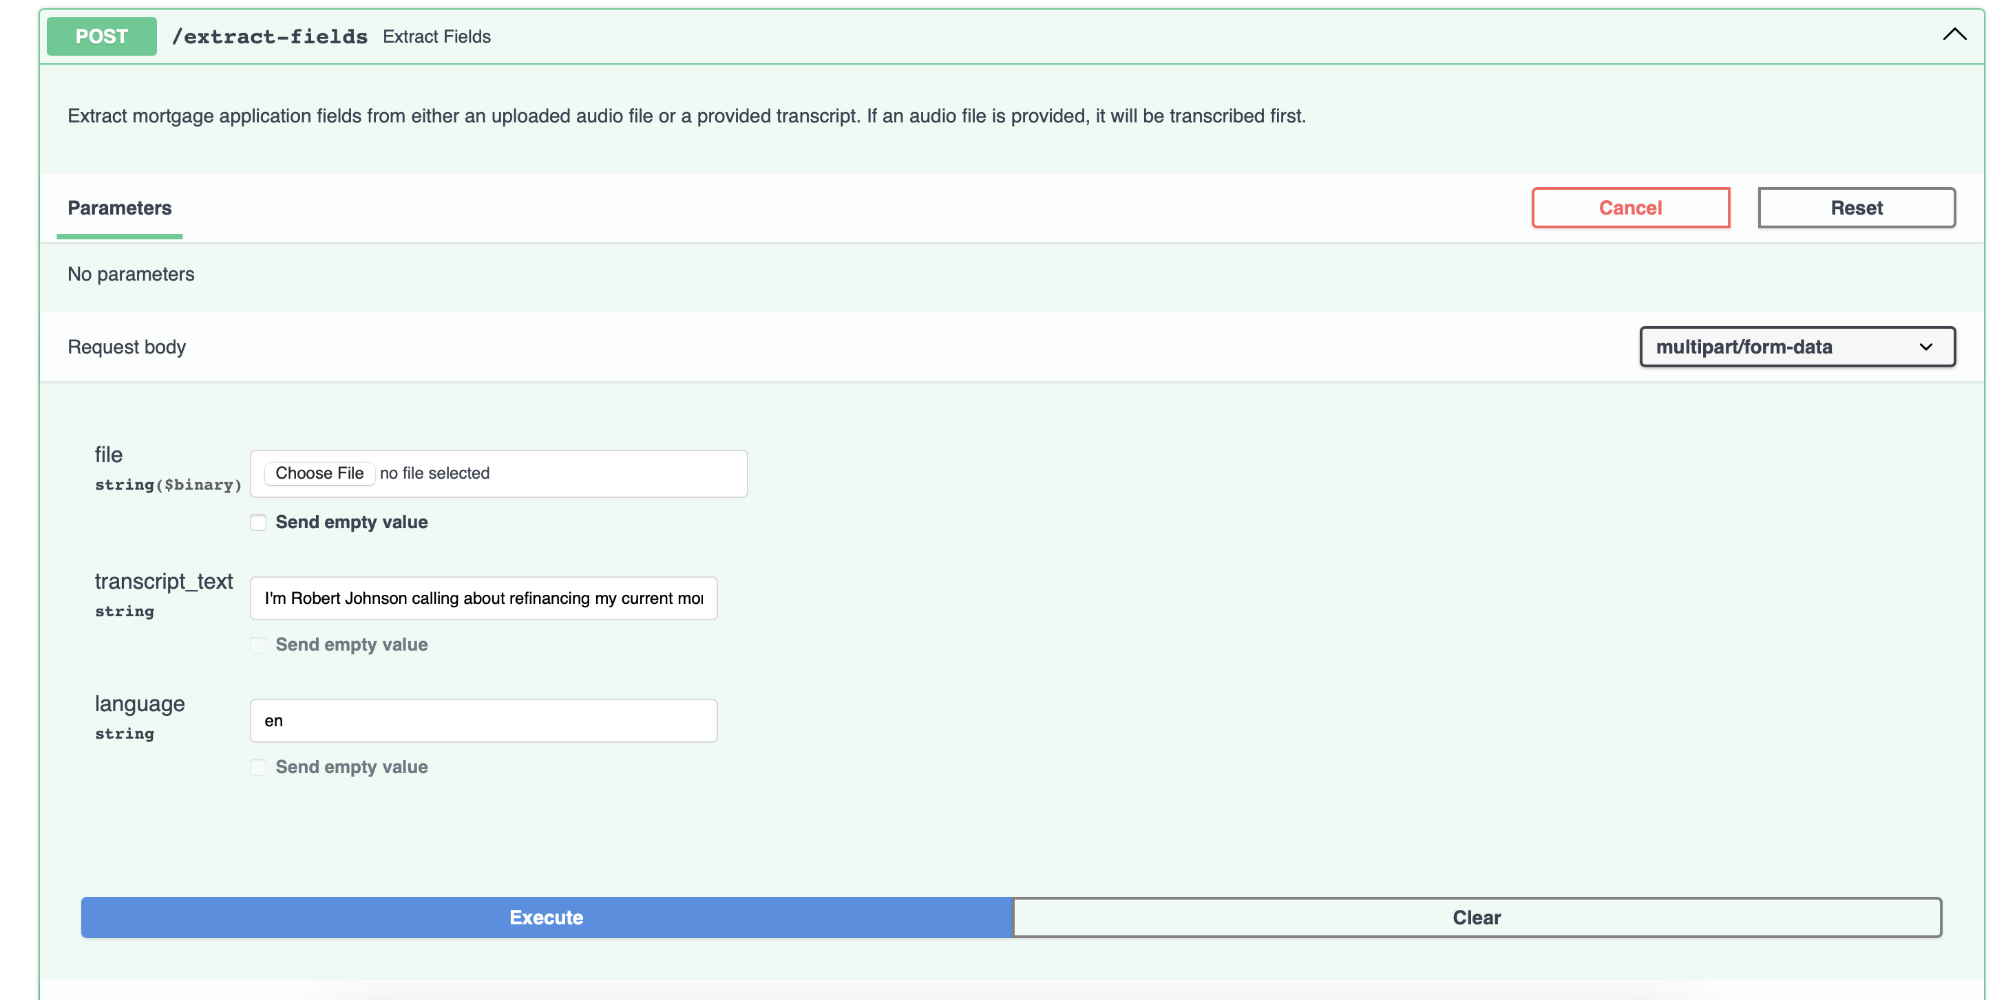
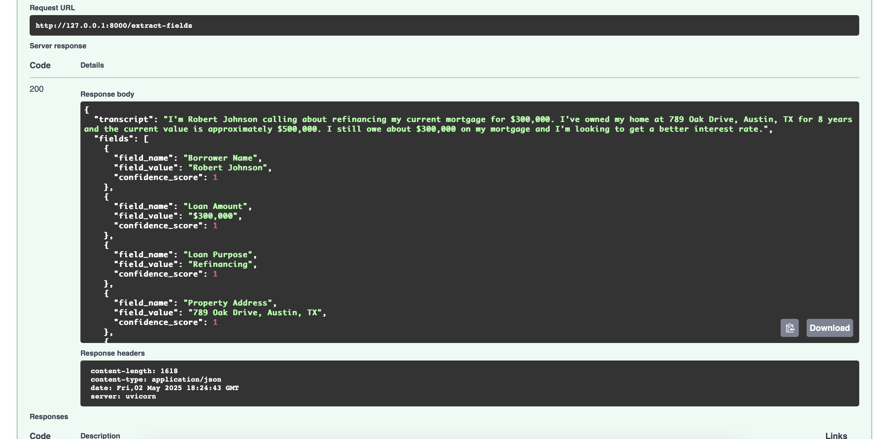
FastAPI Endpoint 1 - /extract-fields
Input format
Returns JSON object

Slide 13
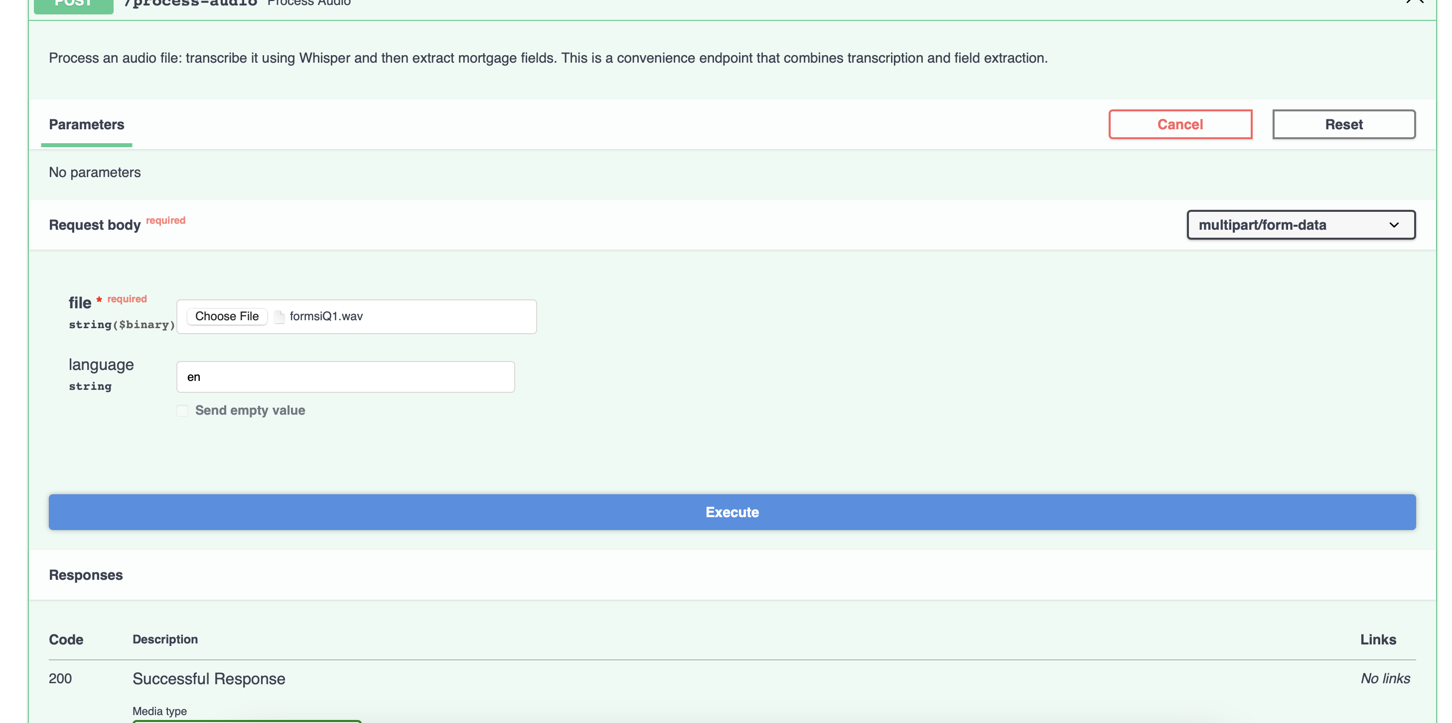
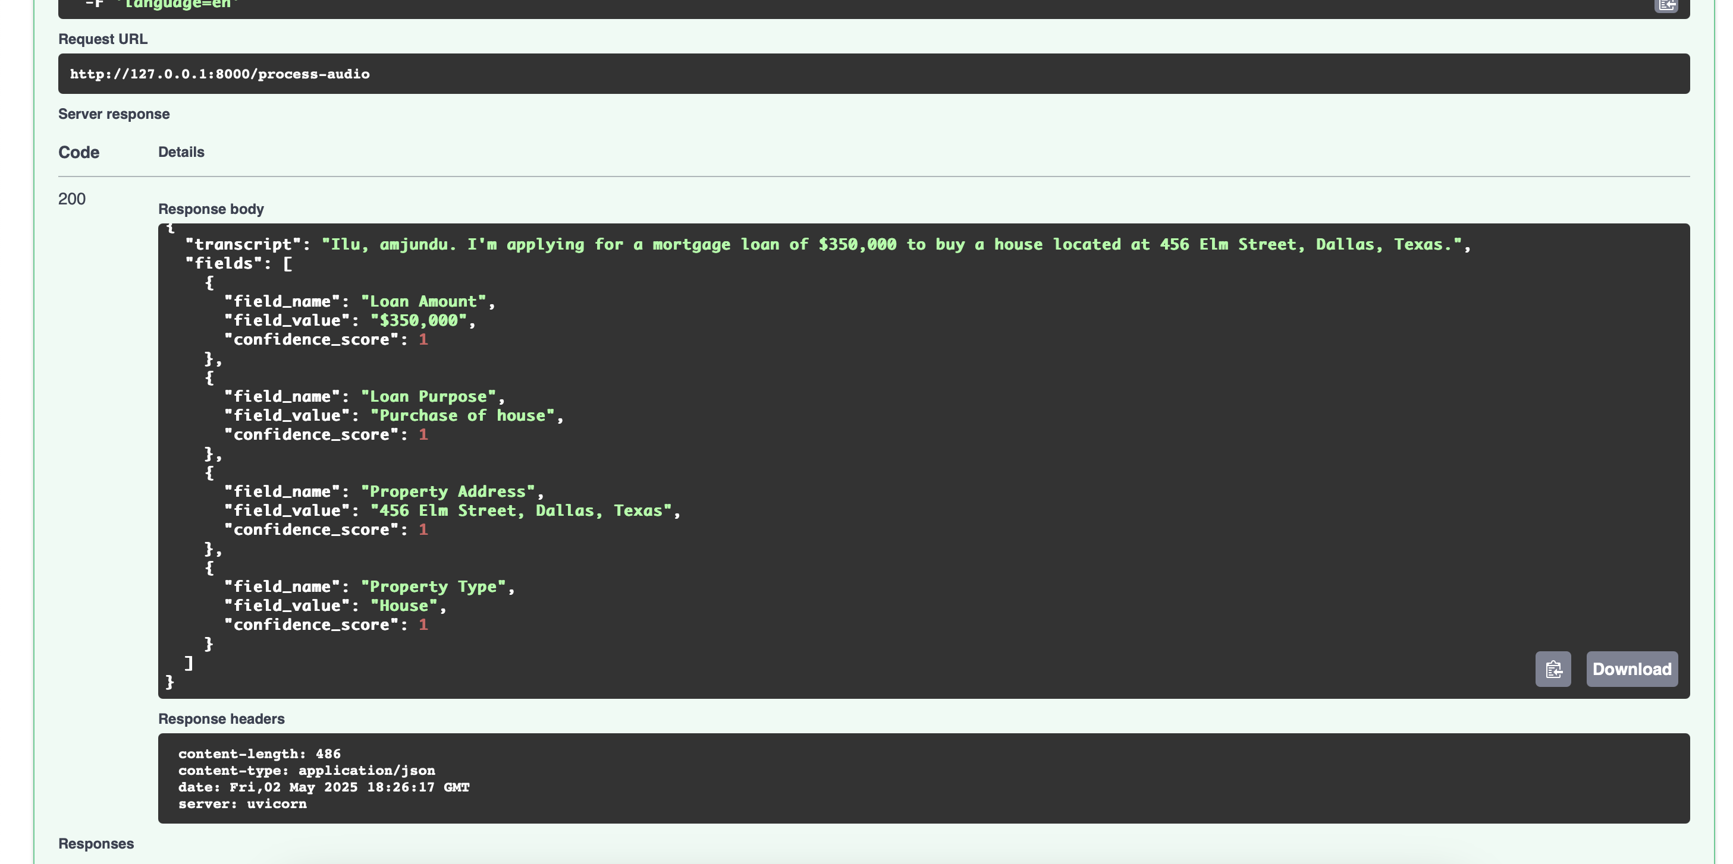
FastAPI Endpoint 2 - /process-audio
Input format
Returns JSON object

Slide 14
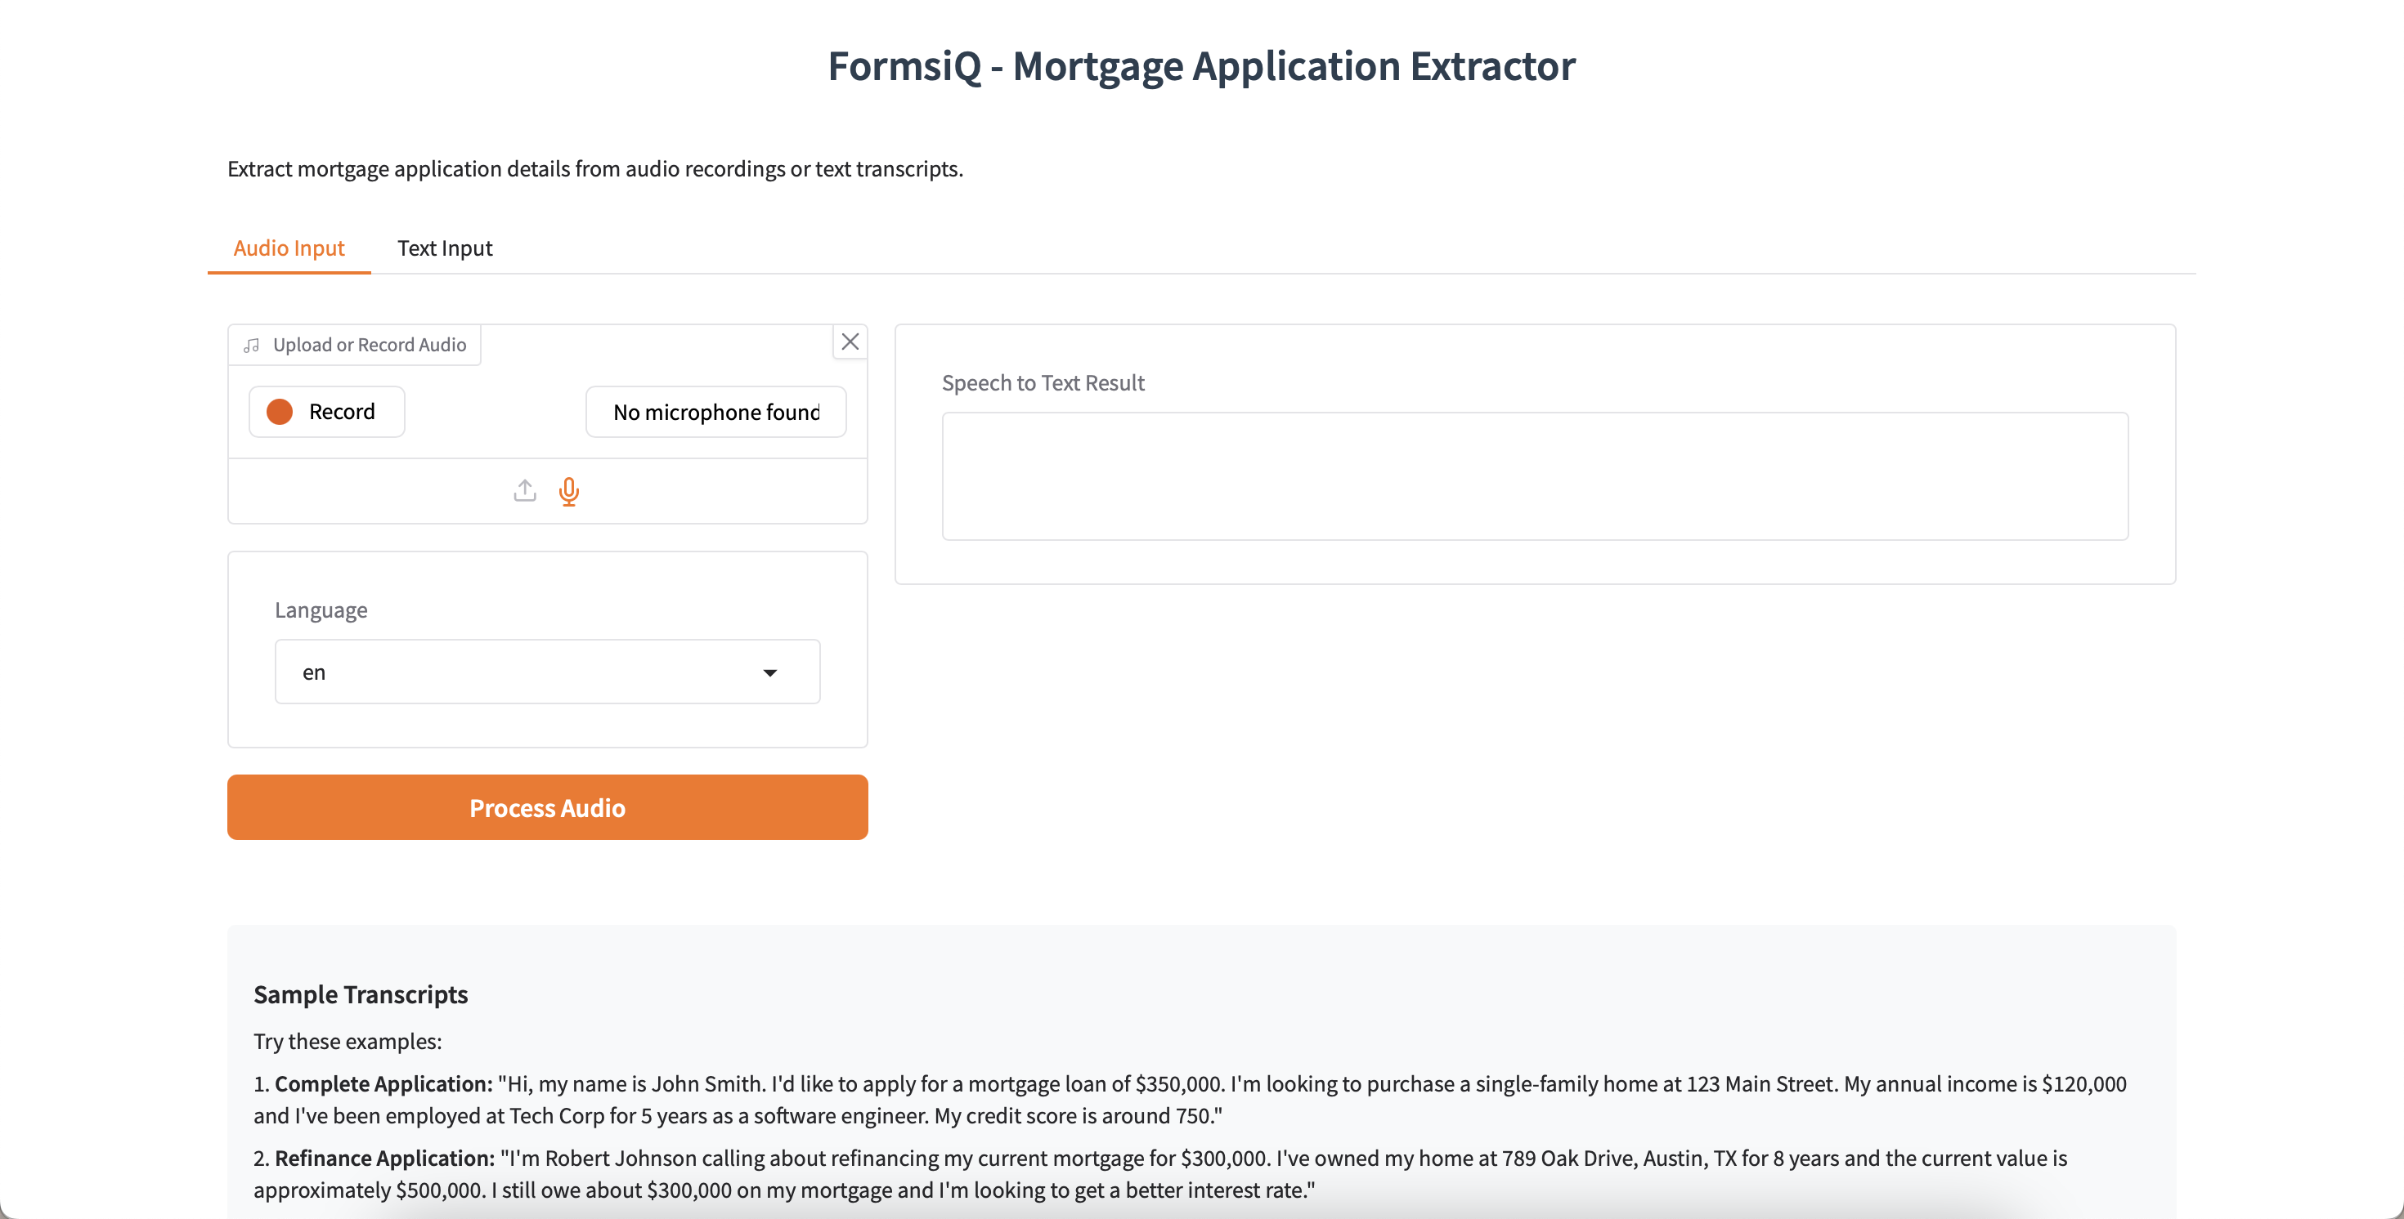
UI Screen Sample
Output components
Transcribed result box
Extracted fields
Confidence score
Input components
Audio or text
Upload file
Record audio
Language drop down
Process button

Slide 15
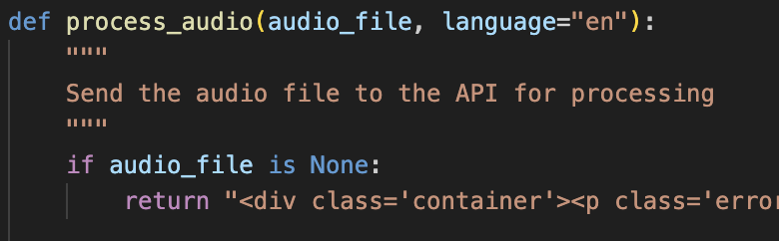
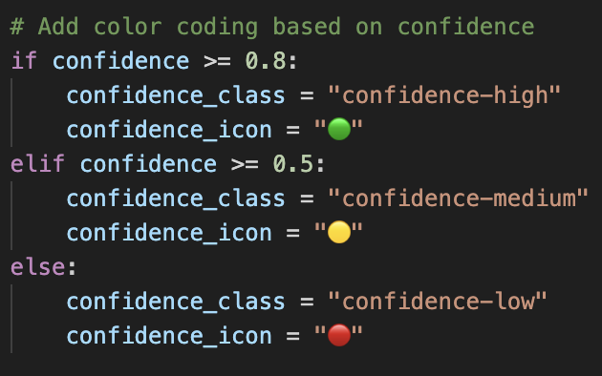
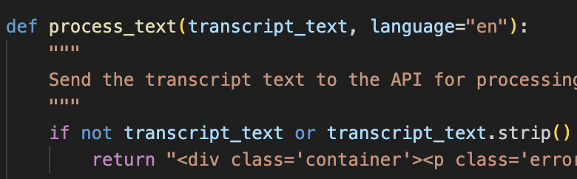
Code snippet – Gradio UI
Assigns visual indicators based on the Confidence score of the AI's output. This helps users quickly see how certain AI is about all extracted fields.
Defines functions to process_audio by taking audio input and process_text to handle text-based transcripts.

Slide 16
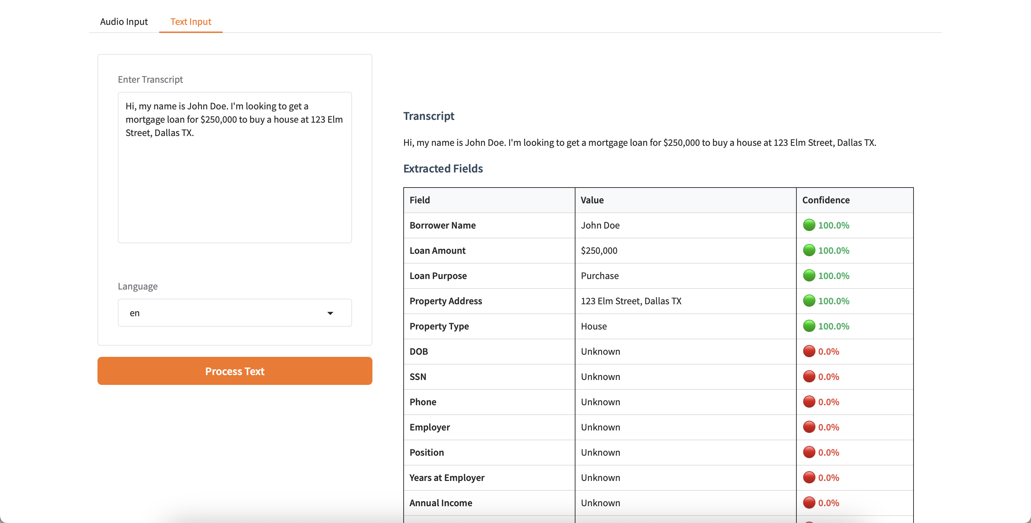
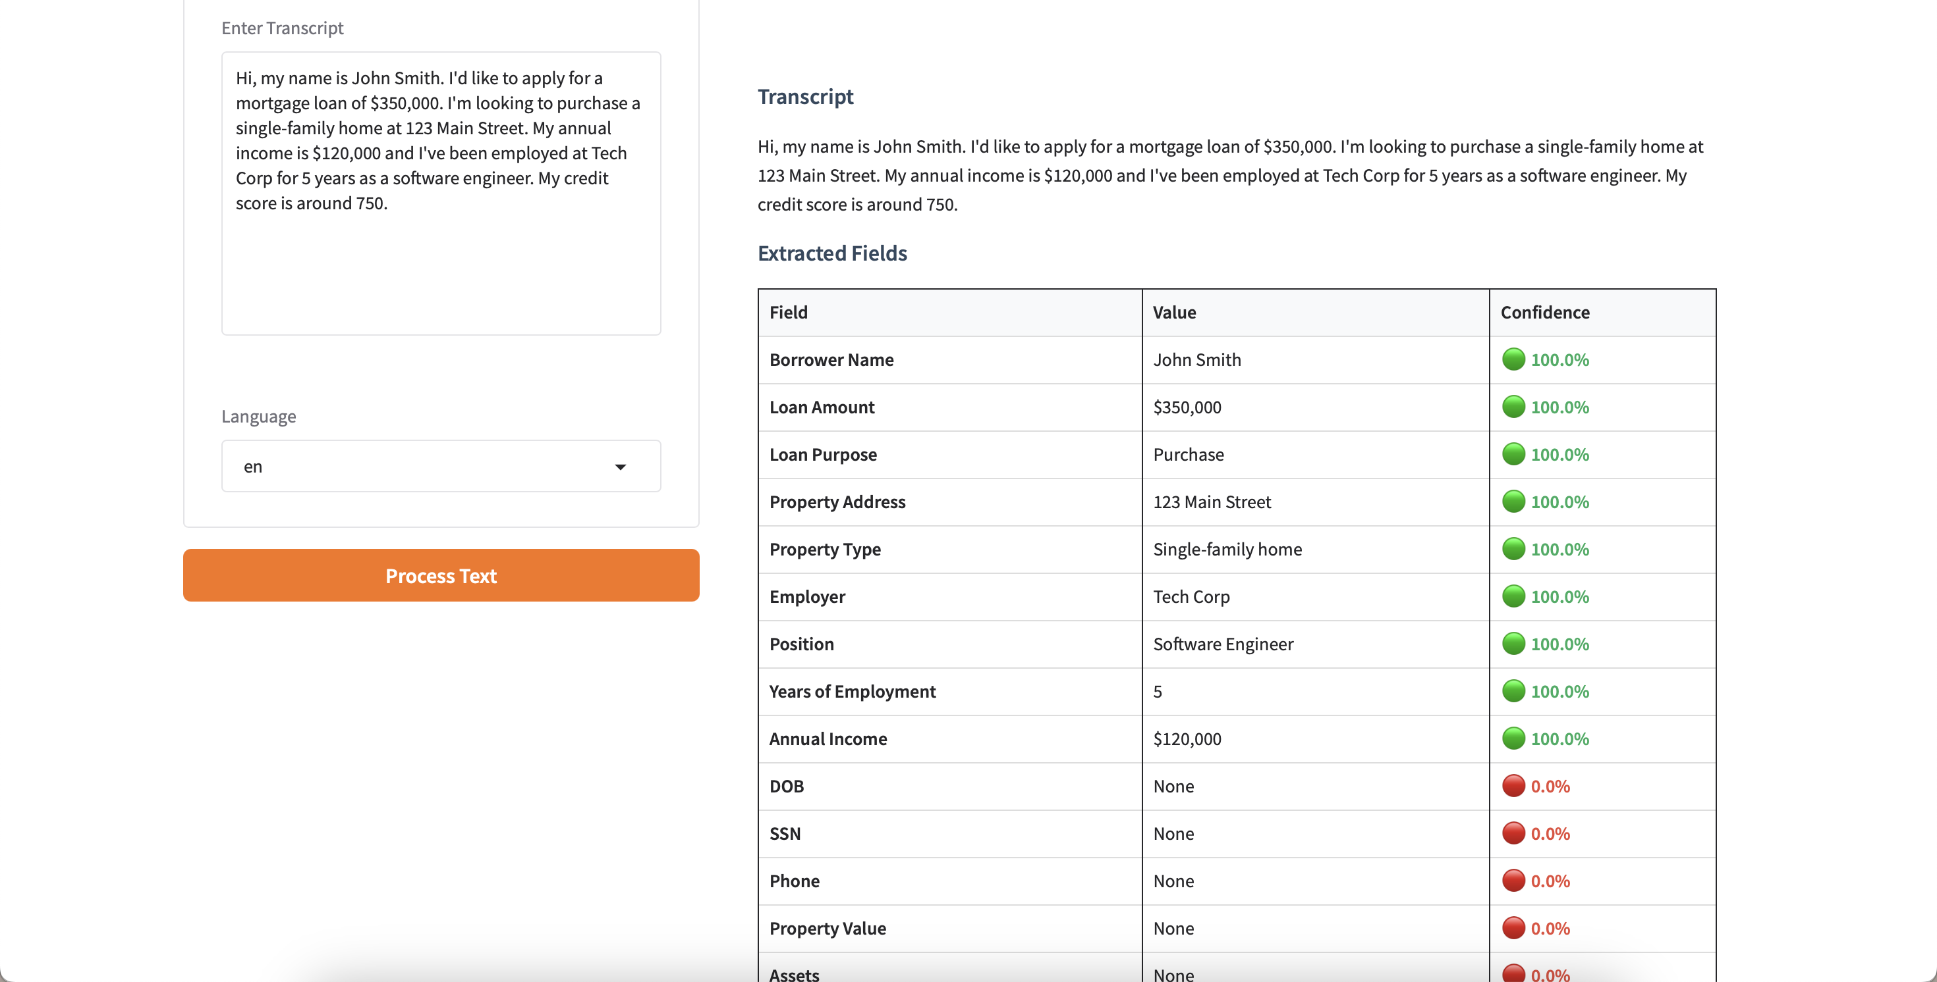
Test Results – Positive 1 (text)

Slide 17
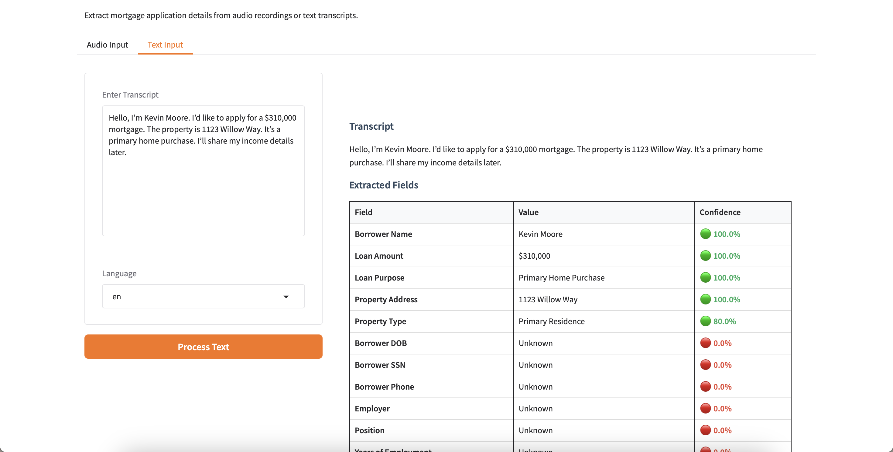
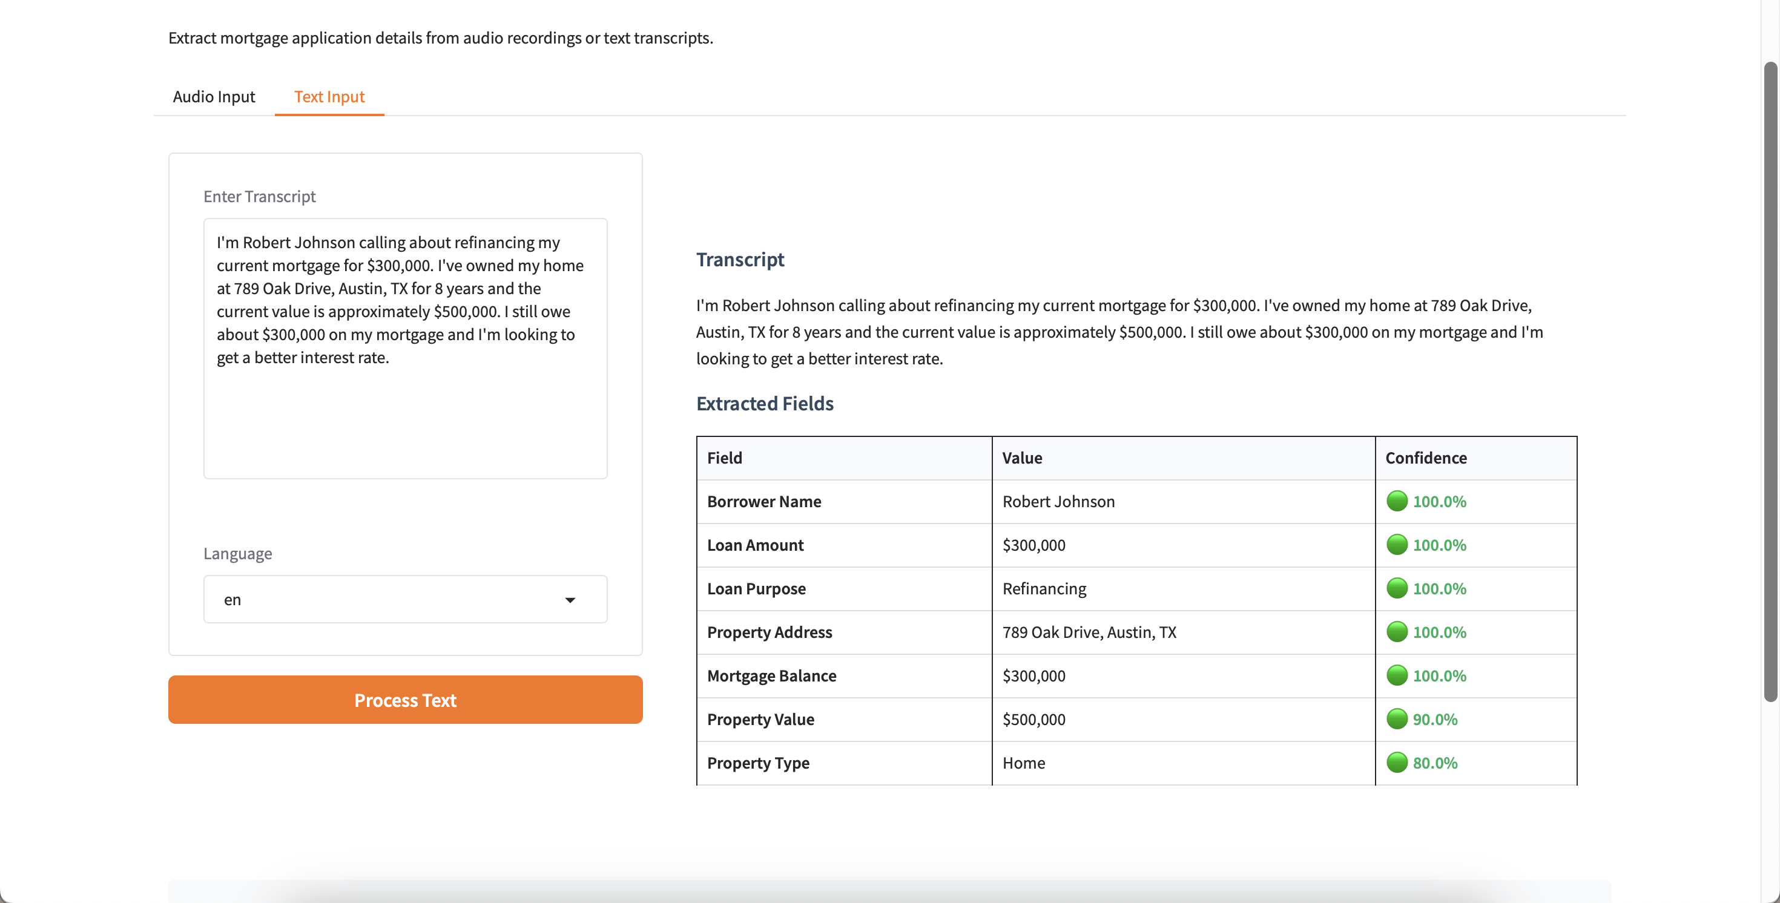
Test Results – Positive 2 (text)

Slide 18
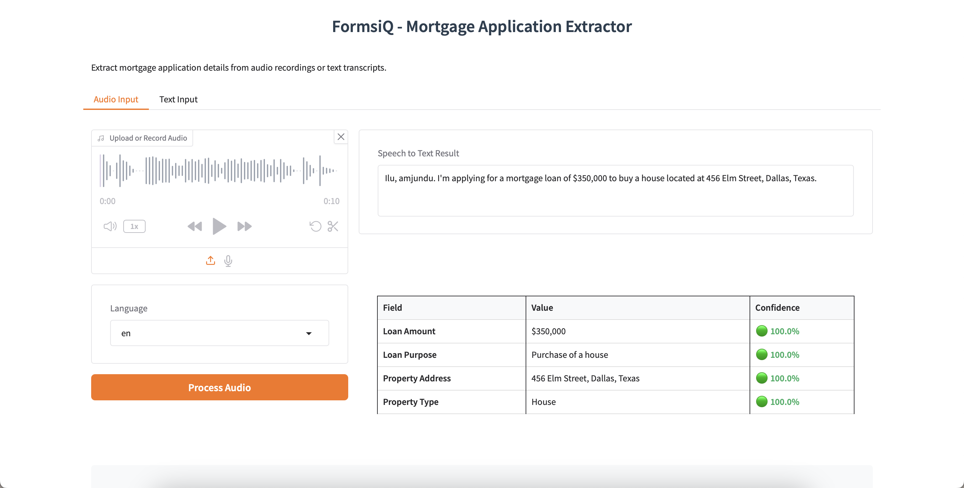
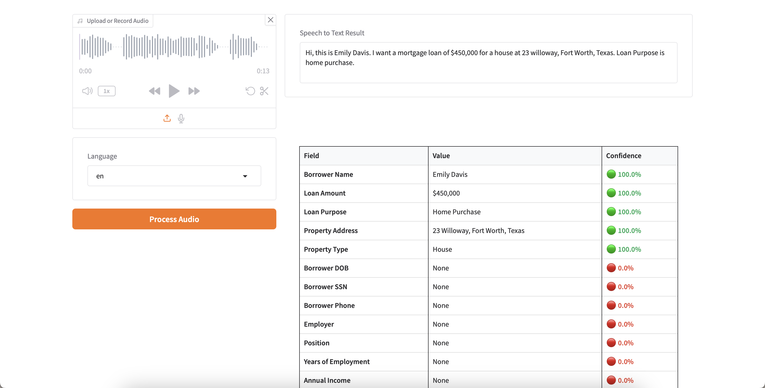
Test Results – Positive 3 (audio)

Slide 19
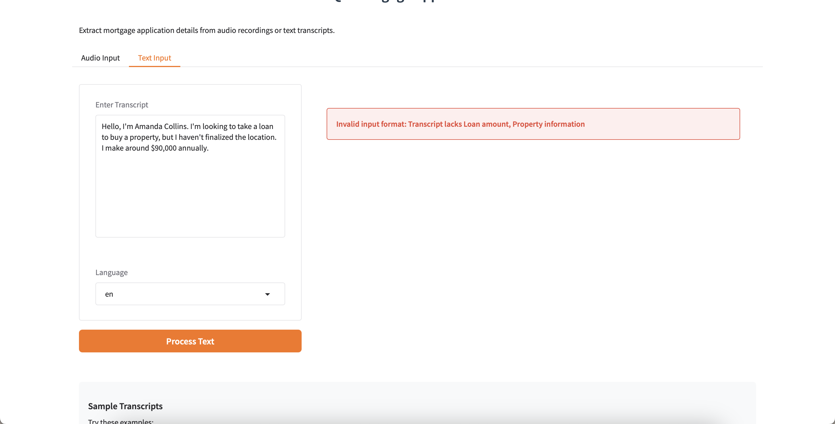
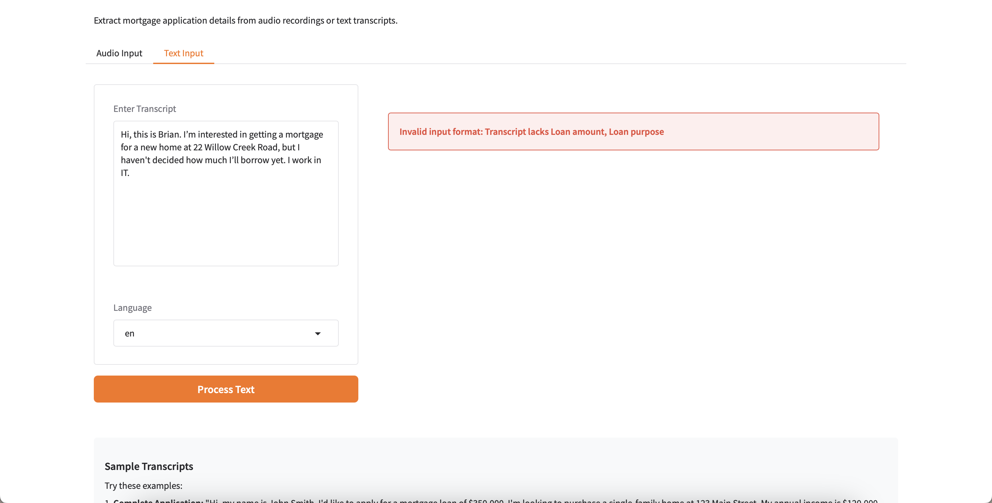
Test Results – Negative 1 (text)

Slide 20
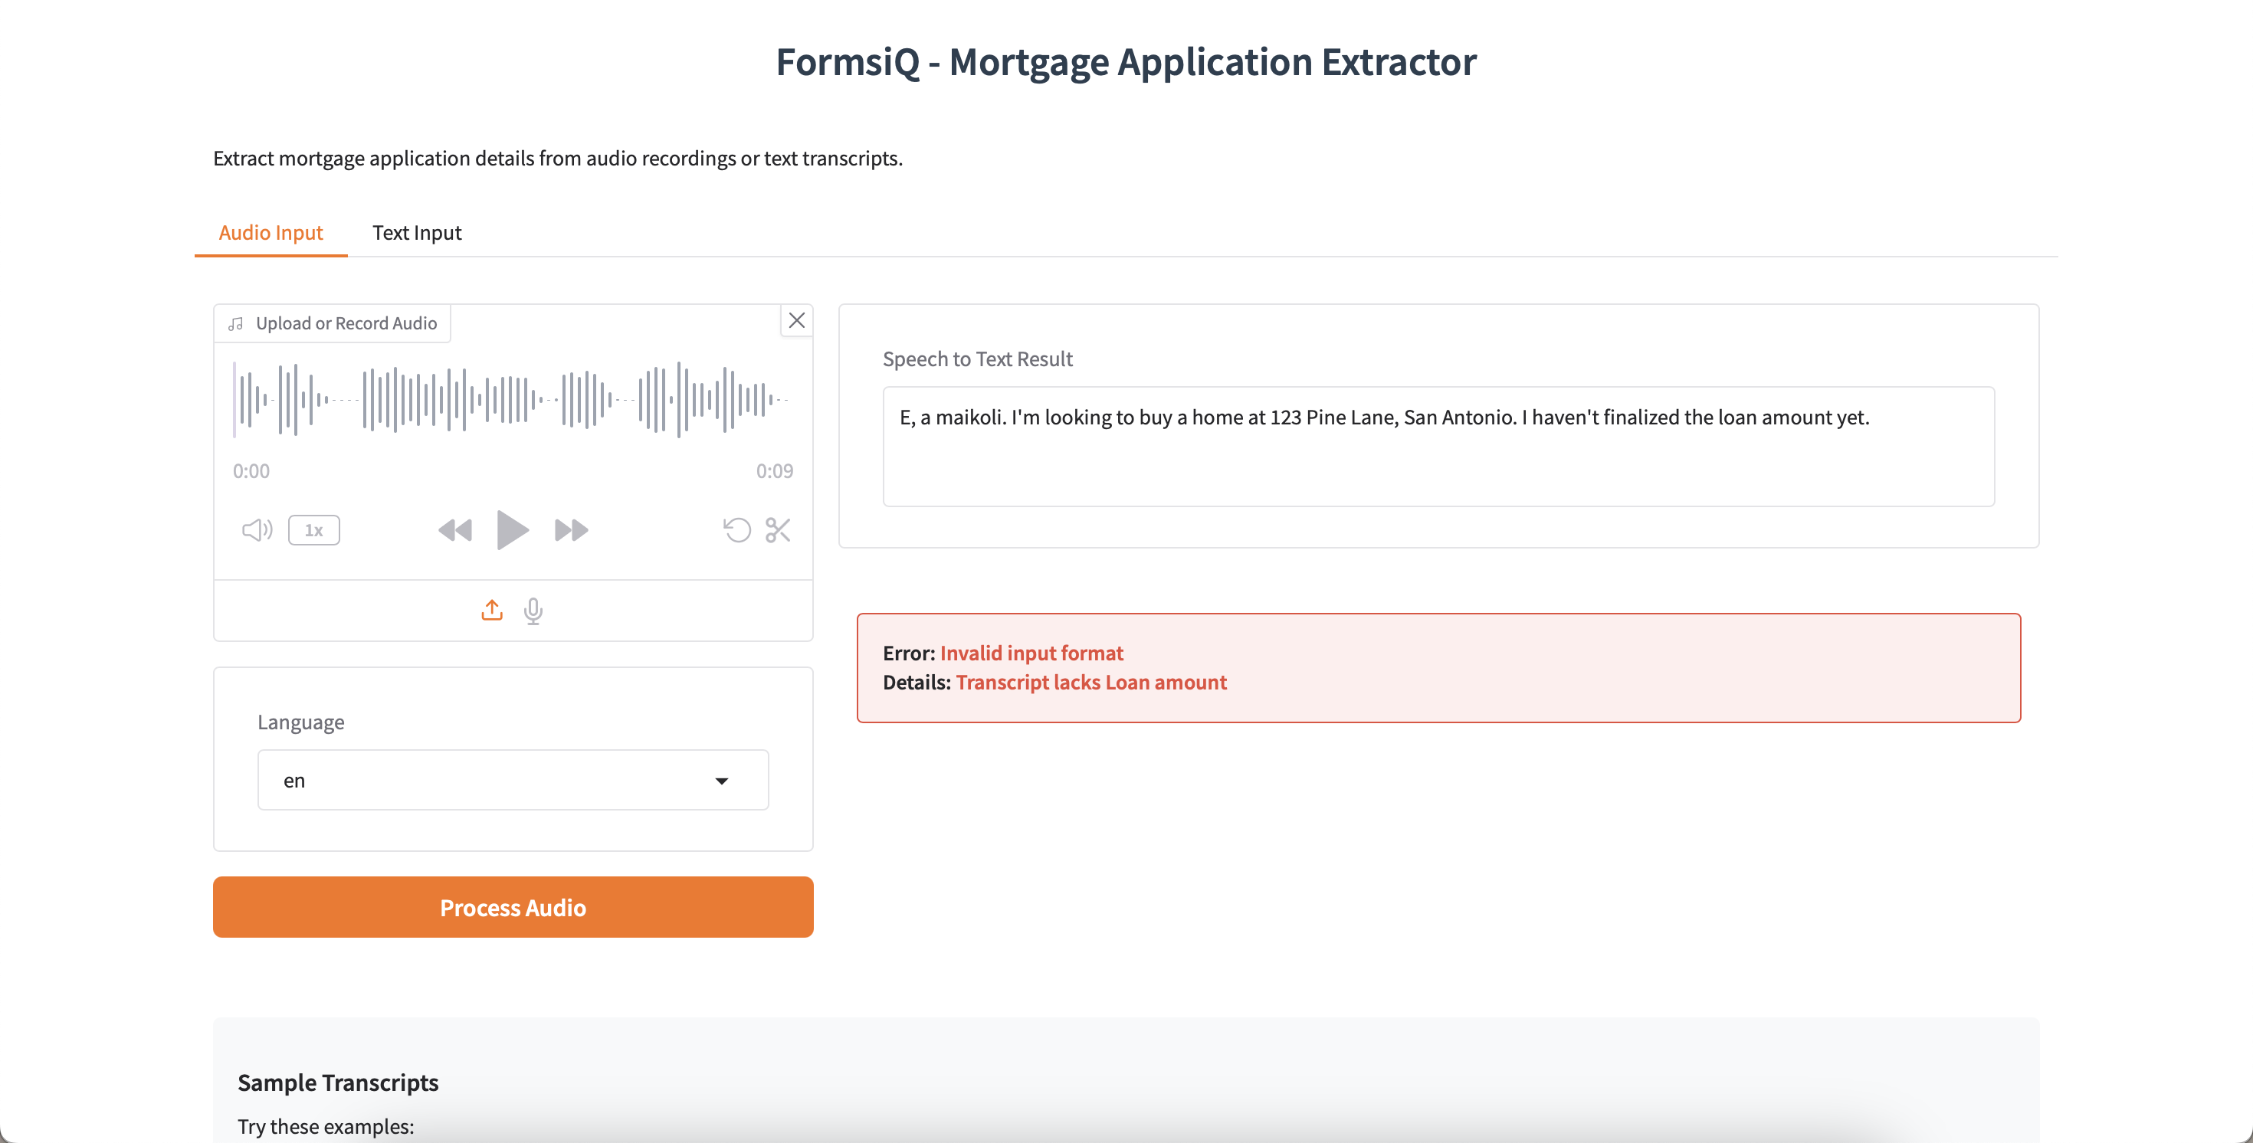
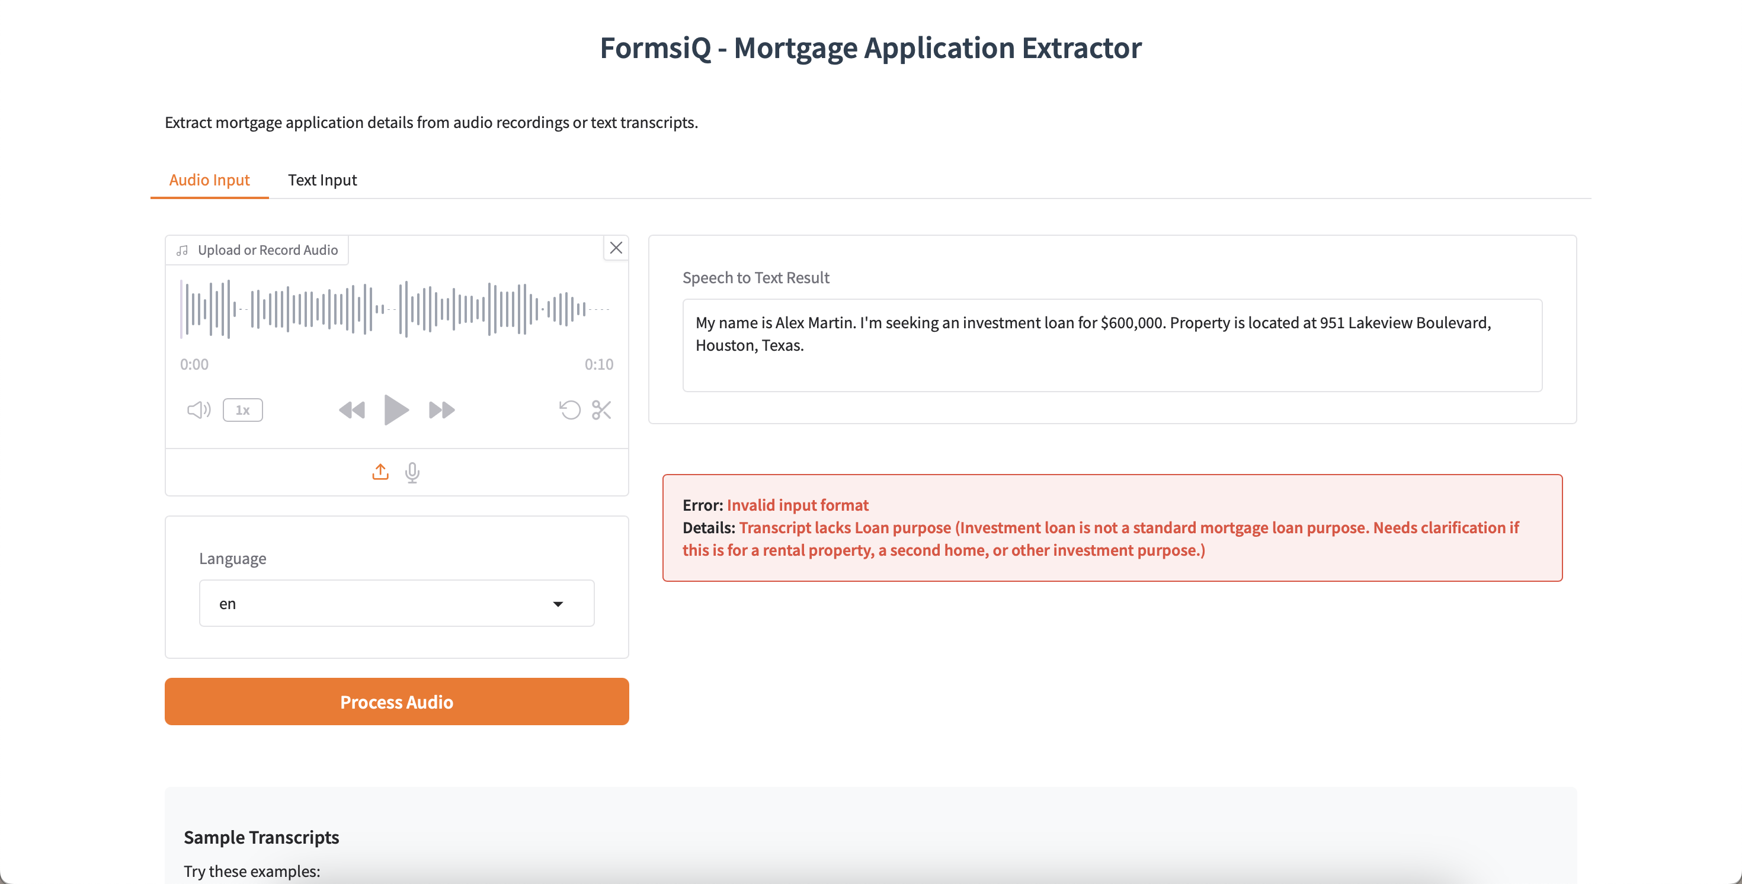
Test Results – Negative 2 (audio)

Slide 21


Problems that mortgage companies might face -
Problems I think AI might solve with respect to form 1003 -
Inconsistent capture of data or wrong interpretation
Waiting to connect to a call agent
Time consuming
Delays in starting application process
Automated and instant extraction of form fields
Identifies unqualified or unnecessary leads early
Scales effortlessly to handle large call volumes
Instant feedback and better customer service
Confidence scores for easy validation

Slide 22
Conclusion
Makes Form 1003 filling easy and fast
Built a scalable and modular GenAI solution using FastAPI, Gradio, Python, Prompt engineering and Google’s generative AI SDK
Implemented robust validation and error handling methods
Improved field capture accuracy and enhanced customer service potential
Easily extendable to other features and domains

Slide 23
{ "message": "Thank you", "confidence_score": 1.0, "feedback": "Your attention is highly appreciated" }
Bringing structured intelligence to unstructured conversations

